Slide 1
Grid Data Handling from Grib File using Pygrib

Slide 2
pygrib

Slide 3
pygrib
High-level python interface to ECCODES library for GRIB file IO pygrib documentation: https://jswhit.github.io/pygrib/

Slide 4
import pygrib in Python
import pygrib

Slide 5
open a GRIB file
grbs = pygrib.open(‘*{path to grib file}’)

Slide 6
display total number of GRIB messages
grbs.messages

Slide 7
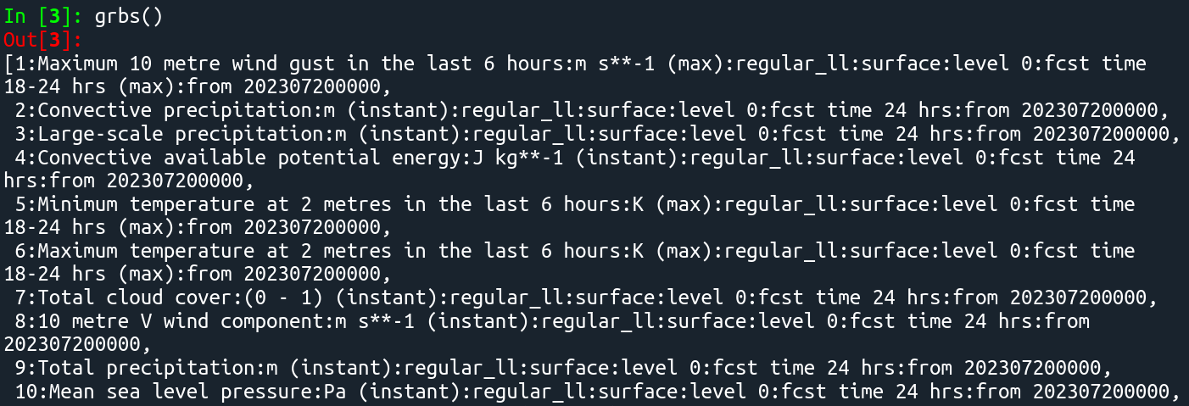
display GRIB messages
grbs()

Slide 8
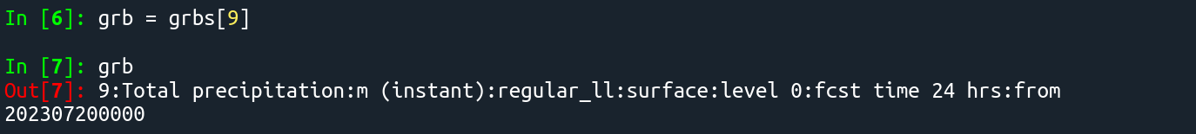
select a grib message
grb = grbs[9]

Slide 9
select grib message of a specific parameter
grb = grbs.select(*args)[0]
*args: shortName - parameter name in short form level - pressure level stepRange - forecast hour step range perturbationNumber - member for ensemble data channelNumber - channel number of simulated satellite data

Slide 10
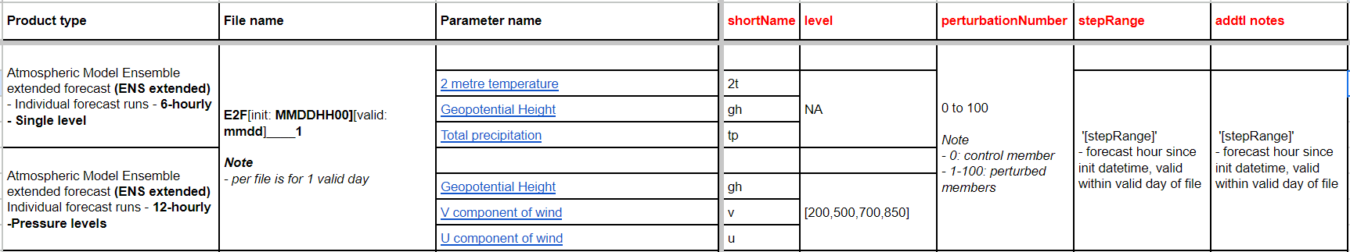
select grib message of a specific parameter
ECMWF Data Files Guide

Slide 11
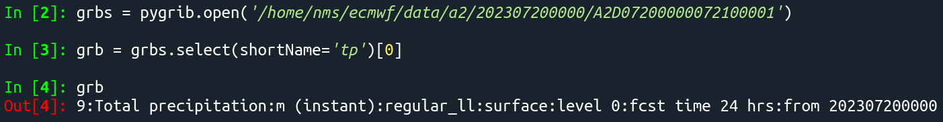
select grib message of a specific parameter
Atmospheric Model high resolution 10-day forecast (HRES) - Single level
select Total Precipitation: grb = grbs.select(shortName='tp')[0]

Slide 12
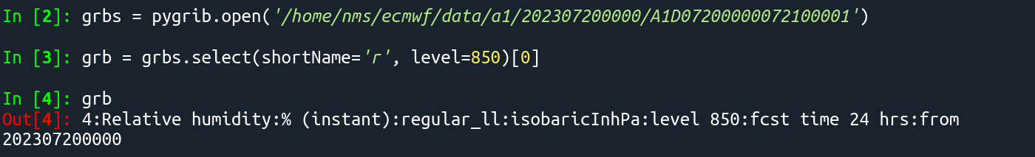
select grib message of a specific parameter
Atmospheric Model high resolution 10-day forecast (HRES) - Pressure levels
select Relative Humidity at 850hPa level: grb = grbs.select(shortName='r', level=850)[0]

Slide 13
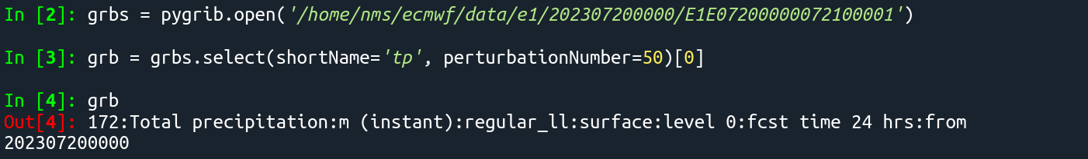
select grib message of a specific parameter
Atmospheric Model Ensemble 15-day forecast (ENS) - Single level
select Total Precipitation for the 50th ensemble member: grb = grbs.select(shortName='tp', perturbationNumber=50)[0]

Slide 14
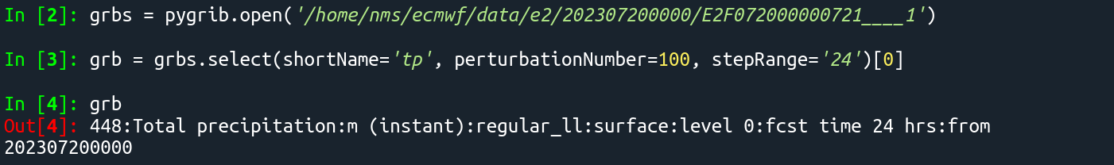
select grib message of a specific parameter
Atmospheric Model Ensemble extended forecast (ENS extended) - Individual forecast runs - 6-hourly - Single level
select Total Precipitation for the 100th ensemble member at forecast hour 24 from initialization: grb = grbs.select(shortName='tp', perturbationNumber=100, stepRange='24')[0]

Slide 15
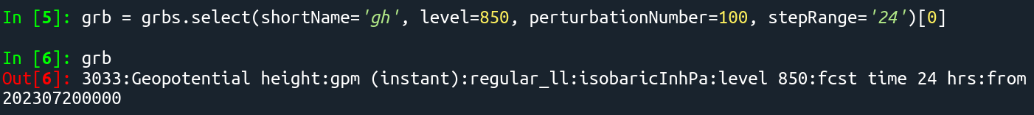
select grib message of a specific parameter
Atmospheric Model Ensemble extended forecast (ENS extended) Individual forecast runs - 12-hourly -Pressure levels
select Geopotential Height at the 850hPa level for the 100th ensemble member at forecast hour 24 from initialization: grb = grbs.select(shortName='gh', level=850, perturbationNumber=100, stepRange='24')[0]

Slide 16
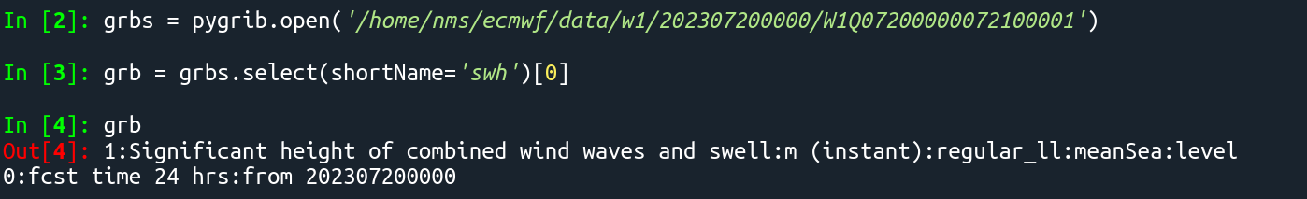
select grib message of a specific parameter
Ocean Wave Model high resolution 10-day forecast (HRES-WAM) - High Resolution Wave Model (HRES-WAM)
select Significant height of combined wind waves and swell: grb = grbs.select(shortName='swh')[0]

Slide 17
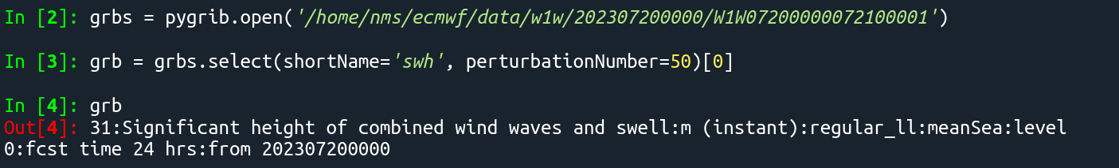
select grib message of a specific parameter
Ocean Wave Model Ensemble 15-day forecast (ENS-WAM) - Wave fields
select Significant height of combined wind waves and swell of the 50th ensemble member: grb = grbs.select(shortName='swh', perturbationNumber=50)[0]

Slide 18
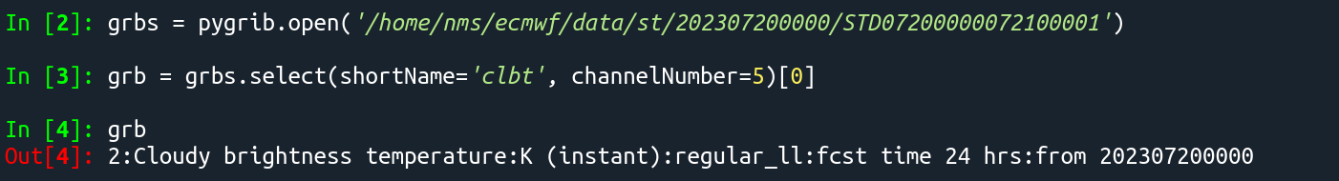
select grib message of a specific parameter
Atmospheric Model high resolution 10-day forecast (HRES) - Simulated Satellite Images
select Cloudy Brightness Temperature for channel 5: grb = grbs.select(shortName='clbt', channelNumber=5)[0]

Slide 19
list available keys of the grib data
grb.keys()
['globalDomain', 'GRIBEditionNumber', 'eps', 'offsetSection0', 'section0Length', 'totalLength', 'editionNumber', 'WMO', 'productionStatusOfProcessedData', 'section1Length', 'wrongPadding', 'table2Version', 'centre', 'centreDescription', 'generatingProcessIdentifier', 'gridDefinition', 'indicatorOfParameter', 'parameterName', 'parameterUnits', 'indicatorOfTypeOfLevel', 'pressureUnits', 'typeOfLevelECMF', 'typeOfLevel', 'level', 'yearOfCentury', 'month', 'day', 'hour', 'minute', 'second', 'unitOfTimeRange', 'P1', 'P2', 'timeRangeIndicator', 'numberIncludedInAverage', 'numberMissingFromAveragesOrAccumulations', 'centuryOfReferenceTimeOfData', 'subCentre', 'paramIdECMF', 'paramId', 'cfNameECMF', 'cfName', 'cfVarNameECMF', 'cfVarName', 'unitsECMF', 'units', 'nameECMF', 'name', 'decimalScaleFactor', 'setLocalDefinition', 'optimizeScaleFactor', 'dataDate', 'year', 'dataTime', 'julianDay', 'stepUnits', 'stepType', 'stepRange', 'startStep', 'endStep', 'marsParam', 'validityDate', 'validityTime', 'validityDateTime', 'deleteLocalDefinition', 'localUsePresent', 'localDefinitionNumber', 'GRIBEXSection1Problem', 'grib2LocalSectionNumber', 'marsClass', 'marsType', 'marsStream', 'experimentVersionNumber', 'perturbationNumber', 'numberOfForecastsInEnsemble', 'oceanAtmosphereCoupling', 'legBaseDate', 'legBaseTime', 'legNumber', 'referenceDate', 'climateDateFrom', 'climateDateTo', 'shortNameECMF', 'shortName', 'ifsParam', 'stepTypeForConversion', 'md5Section1', 'md5Product', 'gridDescriptionSectionPresent', 'bitmapPresent', 'angleSubdivisions', 'section2Length', 'radius', 'numberOfVerticalCoordinateValues', 'neitherPresent', 'pvlLocation', 'dataRepresentationType', 'gridDefinitionDescription', 'gridDefinitionTemplateNumber', 'Ni', 'Nj', 'latitudeOfFirstGridPoint', 'latitudeOfFirstGridPointInDegrees', 'longitudeOfFirstGridPoint', 'longitudeOfFirstGridPointInDegrees', 'resolutionAndComponentFlags', 'ijDirectionIncrementGiven', 'earthIsOblate', 'resolutionAndComponentFlags3', 'resolutionAndComponentFlags4', 'uvRelativeToGrid', 'resolutionAndComponentFlags6', 'resolutionAndComponentFlags7', 'resolutionAndComponentFlags8', 'latitudeOfLastGridPoint', 'latitudeOfLastGridPointInDegrees', 'longitudeOfLastGridPoint', 'longitudeOfLastGridPointInDegrees', 'iDirectionIncrement', 'jDirectionIncrement', 'isGridded', 'scanningMode', 'iScansNegatively', 'jScansPositively', 'jPointsAreConsecutive', 'alternativeRowScanning', 'iScansPositively', 'jScansNegatively', 'scanningMode4', 'scanningMode5', 'scanningMode6', 'scanningMode7', 'scanningMode8', 'swapScanningAlternativeRows', 'jDirectionIncrementInDegrees', 'iDirectionIncrementInDegrees', 'numberOfDataPoints', 'numberOfValues', 'latLonValues', 'latitudes', 'longitudes', 'distinctLatitudes', 'distinctLongitudes', 'zeros', 'PVPresent', 'PLPresent', 'deletePV', 'md5Section2', 'isSpectral', 'lengthOfHeaders', 'md5Headers', 'missingValue', 'tableReference', 'section4Length', 'halfByte', 'dataFlag', 'binaryScaleFactor', 'referenceValue', 'referenceValueError', 'sphericalHarmonics', 'complexPacking', 'integerPointValues', 'additionalFlagPresent', 'orderOfSPD', 'boustrophedonic', 'hideThis', 'packingType', 'bitsPerValue', 'constantFieldHalfByte', 'bitMapIndicator', 'values', 'numberOfCodedValues', 'packingError', 'unpackedError', 'maximum', 'minimum', 'average', 'standardDeviation', 'skewness', 'kurtosis', 'isConstant', 'numberOfMissing', 'dataLength', 'changeDecimalPrecision', 'decimalPrecision', 'bitsPerValueAndRepack', 'setPackingType', 'scaleValuesBy', 'offsetValuesBy', 'gridType', 'getNumberOfValues', 'md5Section4', 'section5Length', 'analDate', 'validDate']

Slide 20
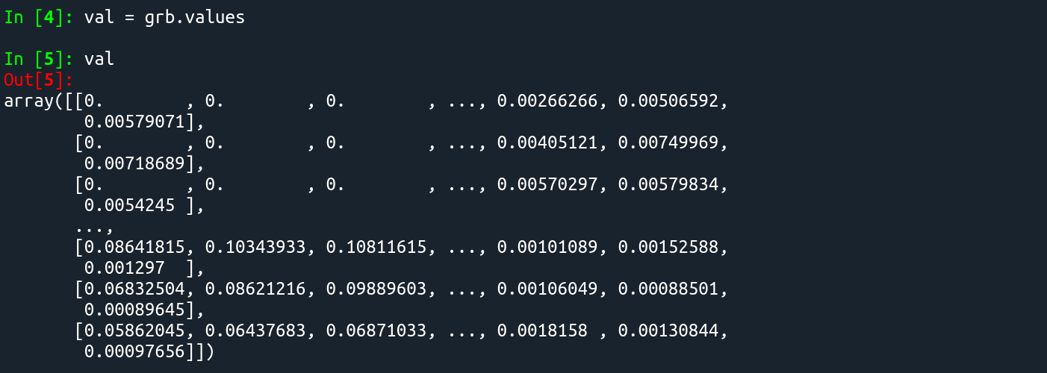
extract data values only
val = grb.values

Slide 21
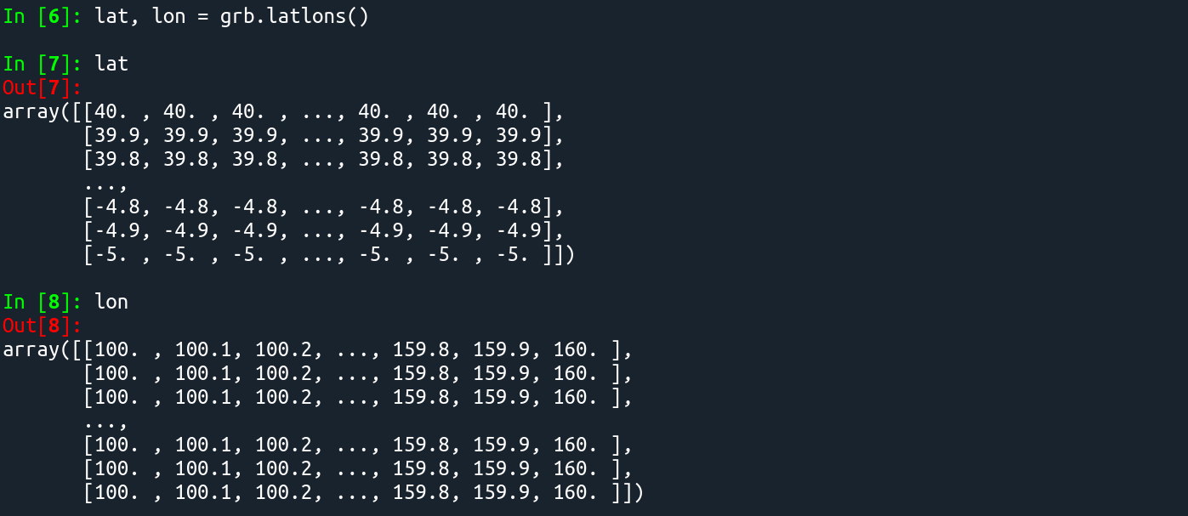
extract lat and lon values only
lat, lon = grb.latlons()

Slide 22
extract data, lat, lon values for a cropped area
ex. for PAR: val, lat, lon = grb.data(lat1=4, lat2=26, lon1=114, lon2=136)

Slide 23
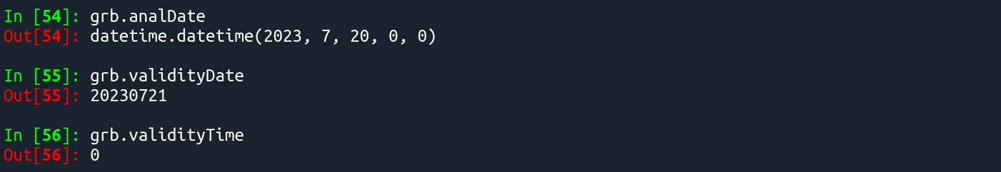
get analysis and valid datetime
Note: - analysis datetime is a datetime object - valid date is an integer - ECMWF data datetime is in UTC

Slide 24
datetime

Slide 25
import datetime in Python
import datetime module and datetime, timedelta classes: from datetime import datetime as dt, timedelta
For datetime documentation and string format options: https://docs.python.org/3/library/datetime.html

Slide 26
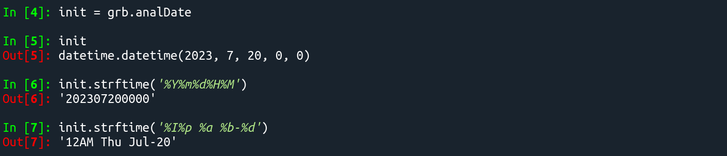
To convert datetime object to string format, use strftime()
*{datetime object}.strftime('*{string format}')

Slide 27
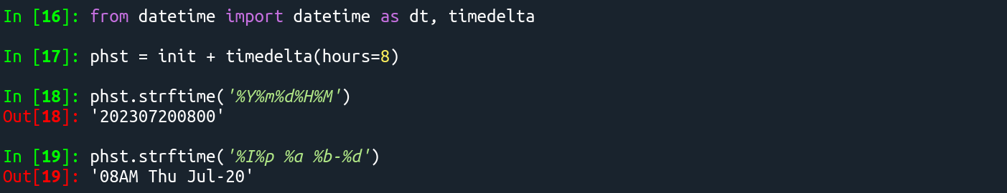
To convert to a different timezone, add time difference using timedelta:
*{datetime object} + timedelta(hours=8)

Slide 28
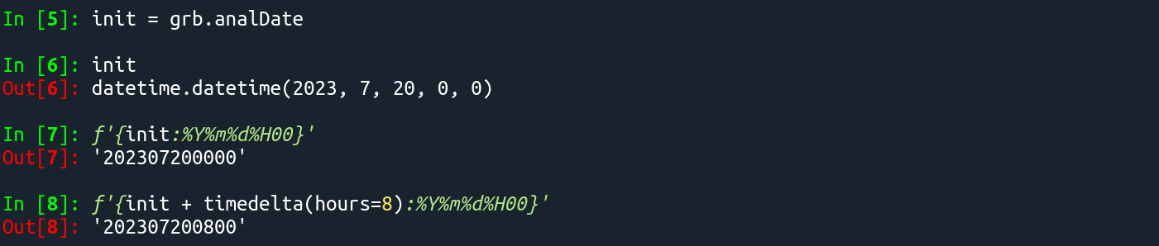
To convert datetime object to string format, use f string formatting
f'{*{datetime object}:*{string format}}'
f'{*{datetime object} + timedelta(hours=8):*{string format}}'

Slide 29
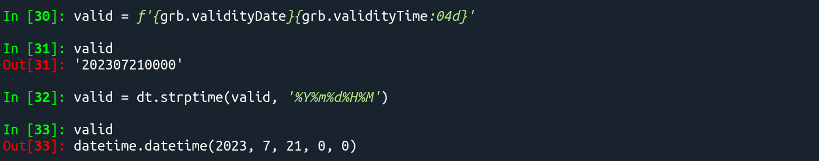
To convert string to datetime object, use strptime()
dt.strptime(*{string to convert}, '*{format of string to convert}')

Slide 30
grid data pre-processing

Slide 31
Note
some parameters have units that needs to be converted
Precipitation data is in meter m, need to convert to mm
Temperature data is in Kelvin K, need to convert to °C
Mean sea level pressure is in Pascal Pa, need to convert to hectoPascal hPa
Winds are in u and v components and are in meter per second m/s, still need to get the wind speed
Total Precipitation is the accumulation from forecast hour +0
some parameters are only available at specific forecast hours
only available at 3-hourly / 6-hourly forecast hours
10 metre wind gust in the last 3 hours / 6 hours
Averaged total lightning flash density in the last 3 hours / 6 hours

Slide 32
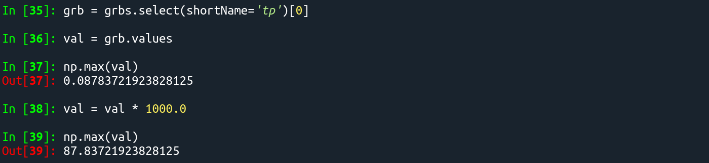
for Precipitation: convert from m to mm

Slide 33
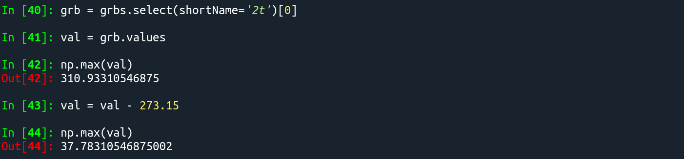
for Temperature: convert from K to °C

Slide 34
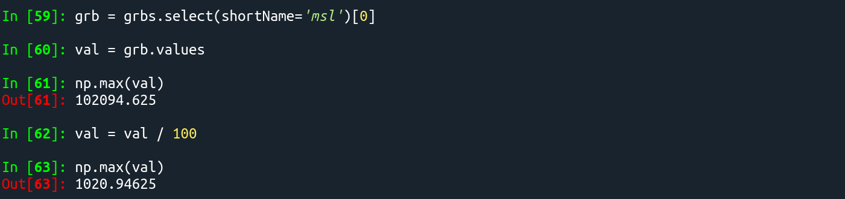
for Mean sea level pressure: convert from Pa to hPa

Slide 35
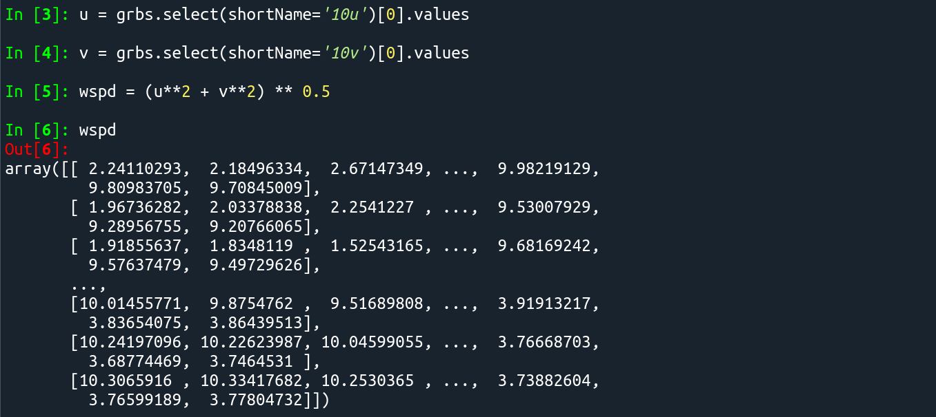
for Wind: get wind speed from u,v components

Slide 36
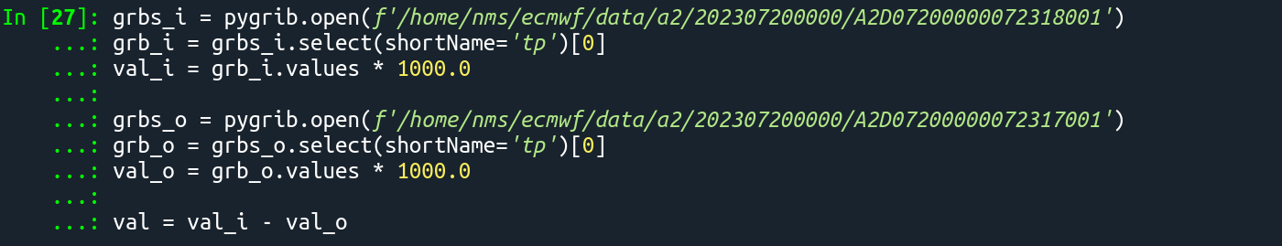
for Total Precipitation: get only accumulation for the valid forecast period

Slide 37
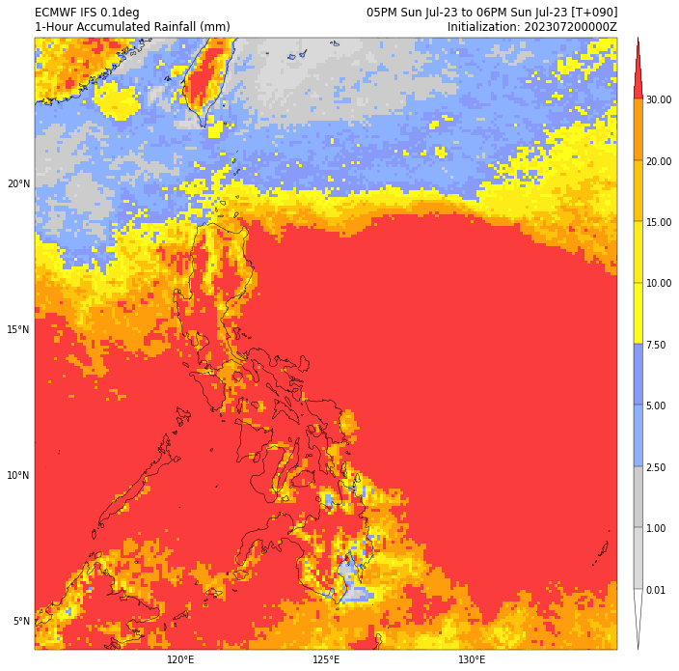
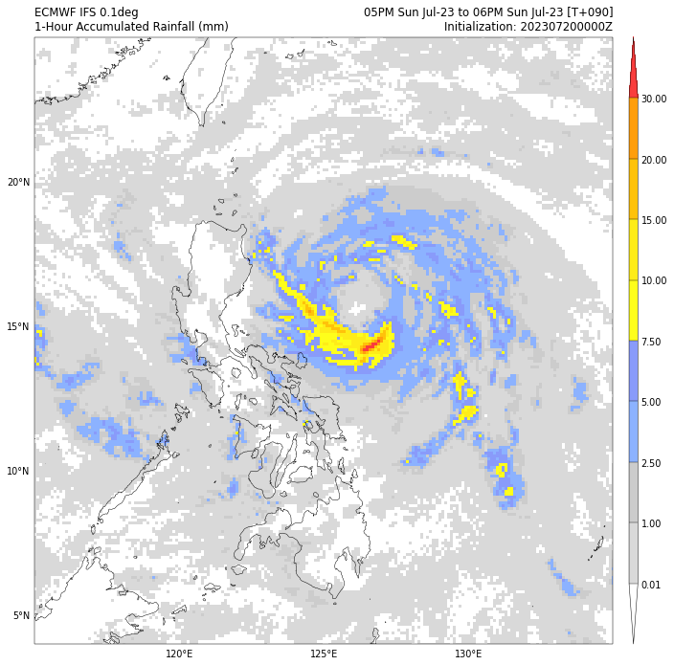

Slide 38
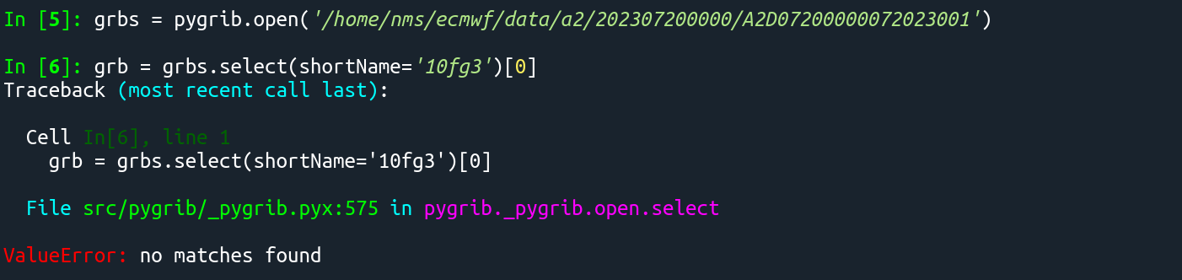
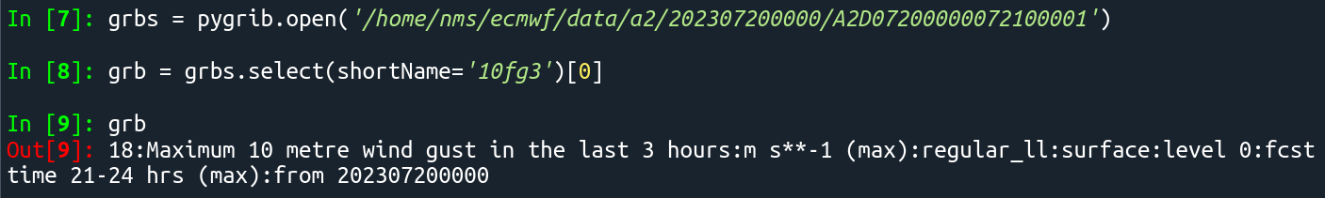
some parameters are only available at specific forecast hours

Slide 39
looping: HRES data

Slide 40
from datetime import datetime as dt, timedelta import pygrib init = '202307200000' init_date = dt.strptime(init, '%Y%m%d%H%M') dts = 'a2' indir = f'/home/nms/ecmwf/data/{dts}/{init}' fhours = list(range(1,90+1,1)) + list(range(93,144+3,3)) + list(range(150,168+6,6))

Slide 41
for fhour in fhours: if fhour in list(range(1,90+1,1)): i=1
elif fhour in list(range(93,144+3,3)): i=3
elif fhour in list(range(150,168+6,6)): i=6 print(f'i:{i}, forecast hour: {fhour}') file = f'A2D{init_date:%m%d%H00}{init_date+timedelta(hours=fhour):%m%d%H00}1' print(f'filename: {file}')

Slide 42
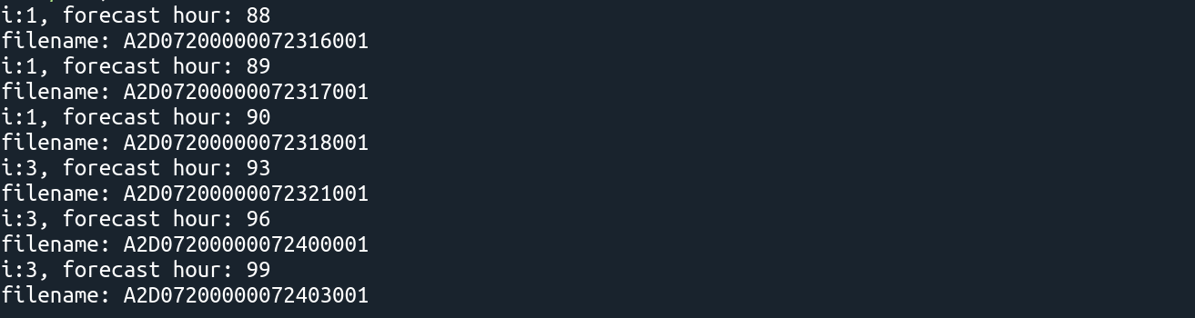

Slide 43
for fhour in fhours: if fhour in list(range(1,90+1,1)): i=1 elif fhour in list(range(93,144+3,3)): i=3 elif fhour in list(range(150,168+6,6)): i=6 print(f'i:{i}, forecast hour: {fhour}') file = f'A2D{init_date:%m%d%H00}{init_date+timedelta(hours=fhour):%m%d%H00}1' print(f'filename: {file}') grbs = pygrib.open(f'{indir}/{file}') grb = grbs.select(shortName='tp')[0] print(grb)

Slide 44
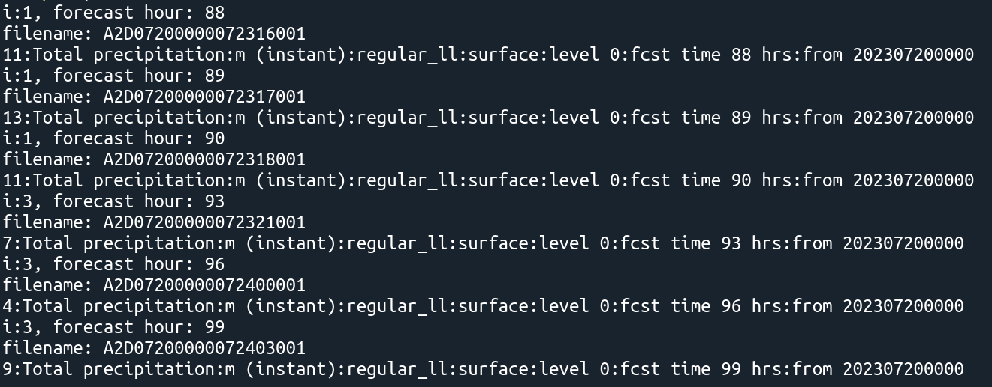

Slide 45
for fhour in fhours: if fhour in list(range(1,90+1,1)): i=1 elif fhour in list(range(93,144+3,3)): i=3 elif fhour in list(range(150,168+6,6)): i=6 print(f'i:{i}, forecast hour: {fhour}') if fhour==1: file_i = f'A2D{init_date:%m%d%H00}{init_date+timedelta(hours=fhour):%m%d%H00}1' grbs_i = pygrib.open(f'{indir}/{file_i}') grb_i = grbs_i.select(shortName='tp')[0]
val = grb_i.values*1000.0 else: file_i = f'A2D{init_date:%m%d%H00}{init_date+timedelta(hours=fhour):%m%d%H00}1' grbs_i = pygrib.open(f'{indir}/{file_i}') grb_i = grbs_i.select(shortName='tp')[0]
file_o = f'A2D{init_date:%m%d%H00}{init_date+timedelta(hours=fhour-i):%m%d%H00}1' grbs_o = pygrib.open(f'{indir}/{file_o}') grb_o = grbs_o.select(shortName='tp')[0]
val = (grb_i.values*1000.0) - (grb_o.values*1000.0)

Slide 46
looping: ENS data

Slide 47
from datetime import datetime as dt, timedelta import numpy as np import pygrib init = '202307200000' init_date = dt.strptime(init, '%Y%m%d%H%M') dts = 'e1' indir = f'/home/nms/ecmwf/data/{dts}/{init}' fhours = list(range(3,144+3,3)) + list(range(150,168+6,6)) for fhour in fhours: if fhour in list(range(93,144+3,3)): i=3 elif fhour in list(range(150,168+6,6)): i=6 print(f'i:{i}, forecast hour: {fhour}')

Slide 48
if fhour==3: file_i = f'E1E{init_date:%m%d%H00}{init_date+timedelta(hours=fhour):%m%d%H00}1' grbs_i = pygrib.open(f'{indir}/{file_i}') for mem in range(0,51): print(f'member: {mem}') grb_i = grbs_i.select(shortName='tp', perturbationNumber=mem)[0] val = grb_i.values*1000.0 mval.append(val) else: file_i = f'E1E{init_date:%m%d%H00}{init_date+timedelta(hours=fhour):%m%d%H00}1' grbs_i = pygrib.open(f'{indir}/{file_i}') file_o = f'E1E{init_date:%m%d%H00}{init_date+timedelta(hours=fhour-i):%m%d%H00}1' grbs_o = pygrib.open(f'{indir}/{file_o}') for mem in range(0,51): print(f'member: {mem}') grb_i = grbs_i.select(shortName='tp', perturbationNumber=mem)[0] grb_o = grbs_o.select(shortName='tp', perturbationNumber=mem)[0] val = (grb_i.values*1000.0) - (grb_o.values*1000.0) mval.append(val)
mval = np.asarray(mval)

Slide 49
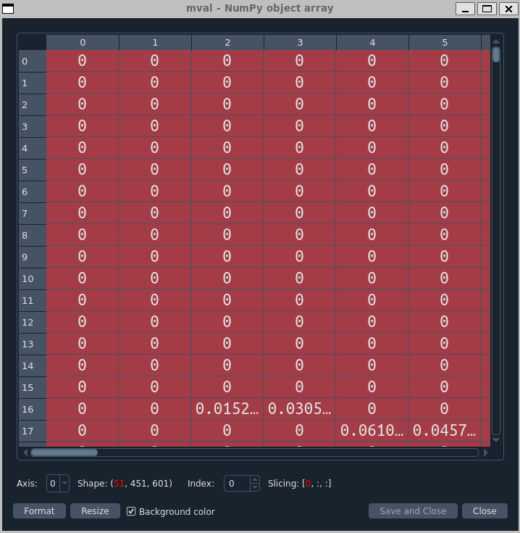
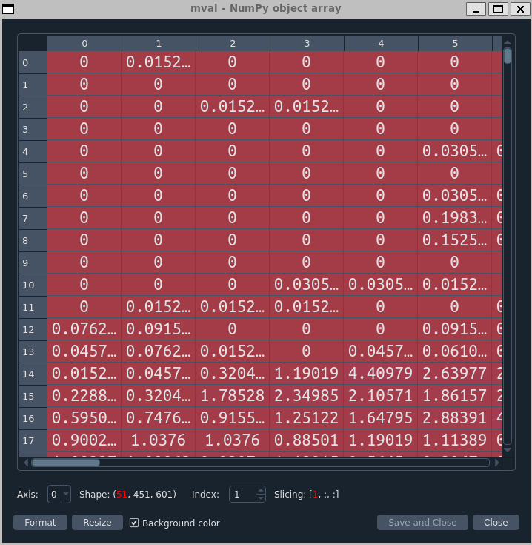
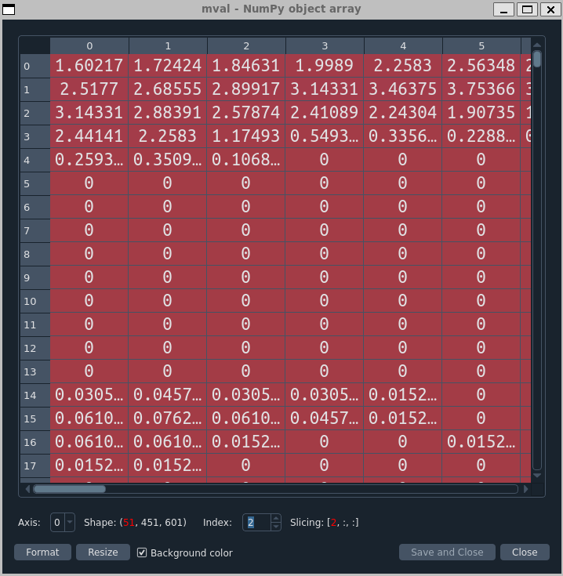

Slide 50
### mean of control + 50 ensemble members mean = np.nanmean(mval, axis=0)
### standard deviation std = np.nanstd(mval, axis=0)
### percentile ptile = np.nanpercentile(mval, [10,25,50,75,90,99], axis=0)
### probability of exceedance thold = 7.5 poe = np.nanmean(np.where(np.isnan(mval), mval, (mval >= thold).astype(int)), axis=0)

Slide 51
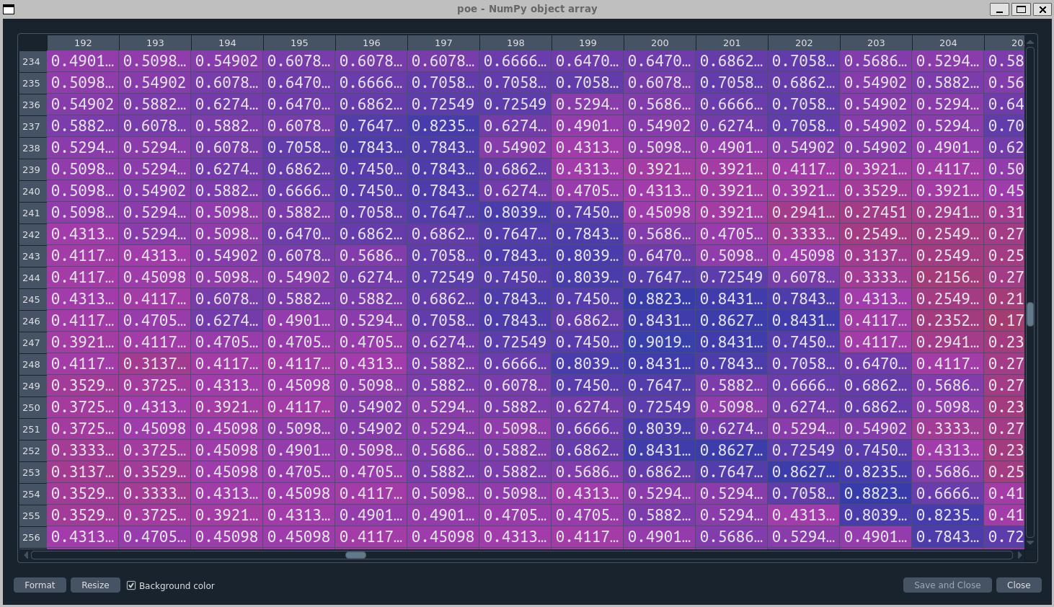

Slide 52
Save grid data as a numpy array file

Slide 53
### Create output directory outdir = f'/home/nms/ecmwf/ens/{dts}/{init}' os.makedirs(outdir, exist_ok=True) . . .
### probability of exceedance thold = 7.5 poe = (np.sum(np.where(mval < thold, 0, 1), axis=0) / len(mval)).round(6) ## Save poe as numpy file np.save(f'{outdir}/ecmwf_poe{thold}_{init_date: %Y%m%d%H}_f{fhour:03d}_{init_date + timedelta(hours=fhour): %Y%m%d%H}.npy', poe)

Slide 54
### Create output directory outdir = f'/home/nms/ecmwf/hres/{dts}/{init}' os.makedirs(outdir, exist_ok=True) . . . if fhour==1: file_i = f'A2D{init_date:%m%d%H00}{init_date+timedelta(hours=fhour):%m%d%H00}1' grbs_i = pygrib.open(f'{indir}/{file_i}') grb_i = grbs_i.select(shortName='tp')[0]
val = grb_i.values*1000.0 else: file_i = f'A2D{init_date:%m%d%H00}{init_date+timedelta(hours=fhour):%m%d%H00}1' grbs_i = pygrib.open(f'{indir}/{file_i}') grb_i = grbs_i.select(shortName='tp')[0]
file_o = f'A2D{init_date:%m%d%H00}{init_date+timedelta(hours=fhour-i):%m%d%H00}1' grbs_o = pygrib.open(f'{indir}/{file_o}') grb_o = grbs_o.select(shortName='tp')[0]
val = (grb_i.values*1000.0) - (grb_o.values*1000.0) ## Save as numpy file np.save(f'{outdir}/ecmwf_hres_pcp_{init_date:%Y%m%d%H}_f{fhour:03d}_{init_date+timedelta(hours=fhour-i):%Y%m%d%H}_to_{init_date+timedelta(hours=fhour):%Y%m%d%H}.npy', val)

Slide 55
End

Slide 56
Extract point values: nearest neighbour

Slide 57
### Create dataframe of nearest neighbour point value for each station
df_stn_nn = pd.DataFrame(columns=['staID','staName','sta_lon','sta_lat','ecm_lon','ecm_lat','pcp'])
### get nearest neighbour point value for each station
for i in range(len(stations)):
## get index of latlon for each station wrt to grid data
abslat = np.abs(lat-stations['lat'][i])
abslon = np.abs(lon-stations['lon'][i])
c = np.maximum(abslon,abslat)
latlon_idx = np.argmin(c)
x, y = np.where(c == np.min(c))
## get station nn latlon
ecm_lon_nn = np.around(lon[x[0],y[0]],decimals=6)
ecm_lat_nn = np.around(lat[x[0],y[0]],decimals=6)
## get nn point value using index of station nn latlon
ecm_val_nn = np.around(val[x[0],y[0]],decimals=6)
## create dict of values
df_nn = {'staID': stations['id'][i], 'staName': stations['staName'][i], 'sta_lon': stations['lon'][i], 'sta_lat': stations['lat'][i], 'ecm_lon': ecm_lon_nn, 'ecm_lat': ecm_lat_nn, 'pcp': ecm_val_nn}
## append dict of values to dataframe
df_stn_nn = pd.concat([df_stn_nn, pd.DataFrame([df_nn])], ignore_index=True)
### save dataframe of nn values
df_stn_nn.to_csv(f'{outdir}/ecmwf_pcp_nn_{init_date: %Y%m%d%H}_f{fhour:03d}_{init_date + timedelta(hours=fhour-i):%Y%m%d%H}_to_{init_date + timedelta(hours=fhour): %Y%m%d%H}.csv', index=False)

